Slide 1
Historic Year 2019-2023 and Forecast to 2032
Global Market of Computers
Type_1: Point_1.1, Point_1.2 (Sub_point_1.2.1) Type_2: Point_2.1 By Region: North America, Europe, Asia-Pacific, Latin America, Middle East & Africa

Slide 2
MARKET SEGMENTATION
Global Market of Computers(USD MILLION)
YEARS CONSIDERED :
Historical year - 2019-2023 | Base year - 2024 | Forecast year - 2025-2032
BY TYPE_1
BY TYPE_2
Point_1.1
Point_1.2
Point_2.1

Slide 3








MARKET TAXONOMY
Global Market of Computers(USD MILLION)
YEARS CONSIDERED :
Historical year - 2019-2023 | Base year - 2024 | Forecast year - 2025-2032
NORTH AMERICA
EUROPE
ASIA PACIFIC
LATIN AMERICA
MIDDLE EAST & AFRICA
Mexico
GCC Countries
United Kingdom
China
Brazil
Canada
Germany
France
Japan
Spain
South Korea
United States
Italy
India
South Africa
United Kingdom
Germany
France
Spain
GCC Countries
South Africa
Rest of MEA
Italy
Rest of Europe
China
Japan
India
Brazil
Mexico
Rest of LATAM
United States
Canada
South Korea
Rest of APAC

Slide 4
TABLE OF CONTENTS-
Global Market of Computers-
Historic Year 2019-2023 and Forecast to 2032

Slide 5

TABLE OF CONTENTS
1. Introduction | 4.6.1. Competitive Rivalry
1.1. Objectives of the Study | 4.6.2. Threat of substitutes
1.2. Market Definition & Scope | 4.6.3. Bargaining power of buyers
2. Research Methodology | 4.6.4. Threat of new entrants
2.1. Research Process | 4.6.5. Bargaining power of suppliers
2.2. Secondary & Primary Data Methods | 5. Key Market Insights
2.3. Market Size Estimation Methods | 5.1. Key Success Factors
2.4. Market Assumptions & Limitations | 5.2. Market Impacting Factors
3. Executive Summary | 5.3. Top Investment Pockets
3.1. Global Market Outlook | 5.4. Market Attractiveness Index
3.2. Key Market Highlights | 5.5. Market Ecosystem
3.3. Segmental Overview | 5.6. PESTEL Analysis
3.4. Competition Overview | 5.7. Pricing Analysis
4. Market Dynamics & Outlook | 5.8. Regulatory Landscape
4.1. Macro-Economic Indicators​ | 5.9. Case Study Analysis
4.2. Drivers & Opportunitiess | 5.10. Value Chain Analysis
4.3. Restraints & Challenges | 6. Global Market of Computers Size by Type_1 (2025-2032)
4.4. Supply Side Trends | 6.1. Point_1.1
4.5. Demand Side Trends | 6.2. Point_1.2
4.6. Porter's Analysis & Impact | 6.2.1. Sub_point_1.2.1

Slide 6
TABLE OF CONTENTS
7. Global Market of Computers Size by Type_2 (2025-2032) | 8.4.1. Brazil
7.1. Point_2.1 | 8.4.2. Mexico
8. Global Market of Computers Size by Region (2025-2032) | 8.4.3. Rest of Latin America
8.1. North America (By Type_1, By Type_2) | 8.5. Middle East & Africa (By Type_1, By Type_2)
8.1.1. US | 8.5.1. GCC Countries
8.1.2. Canada | 8.5.2. South Africa
8.2. Europe (By Type_1, By Type_2) | 8.5.3. Rest of Middle East & Africa
8.2.1. UK | 9. Competitive Dashboard
8.2.2. Germany | 9.1. Top 5 Player Comparison
8.2.3. Spain | 9.2. Market Positioning of Key Players, 2024
8.2.4. France | 9.3. Strategies Adopted by Key Market Players
8.2.5. Italy | 9.4. Recent Developments in the Market
8.2.6. Rest of Europe | 9.5. Company Market Share Analysis, 2024
8.3. Asia-Pacific (By Type_1, By Type_2) | 10. Key Company Profiles
8.3.1. China | 10.1. Apple Inc.
8.3.2. India | 10.1.1. Company Overview
8.3.3. Japan | 10.1.2. Product Portfolio Overview
8.3.4. South Korea | 10.1.3. Financial Overview
8.3.5. Rest of Asia Pacific | 10.1.4. Key Developments
8.4. Latin America (By Type_1, By Type_2) | The following companies are listed for indicative purposes only. Similar information will be provided for each, with detailed financial data available exclusively for publicly listed companies.

Slide 7
10.2. Microsoft Corporation
10.3. Dell Technologies Inc.
10.4. IBM Corporation
10.5. Hewlett-Packard Enterprise
10.6. Lenovo Group Limited
10.7. Cisco Systems Inc.
10.8. Intel Corporation
10.9. ASUS Computer International
10.10. Acer Inc.
11. Conclusion & Recommendation
TABLE OF CONTENTS

Slide 8
TABLE OF CONTENTS

Slide 9
RESEARCH METHODOLOGY
Global Market of Computers -
Historic Year 2019-2023 and Forecast to 2032

Slide 10
RESEARCH METHODOLOGY
Research Objective
The process begins with clearly defining the research objective, which serves as the foundation for the study. This step identifies the specific goals, questions, or problems the research aims to address.
Research Objective
Secondary Research
Secondary research involves collecting existing data from credible sources to build a comprehensive baseline. This stage gathers relevant insights to contextualize the study and identify data gaps.
Data Modelling
Secondary Research
Data Analysis
Primary Research
Primary Research
Primary research directly gathers first-hand data to validate, complement, or update insights obtained during secondary research. It involves interacting with industry stakeholders to provide real-time insights and market perspectives.
Data Modelling
This step involves using data modeling techniques to forecast future trends and market behavior. Predictive modeling ensures informed decision-making by aligning results with economic, industry, and population metrics.
Data Analysis
Data collected through secondary and primary research is rigorously analyzed to uncover patterns, trends, and actionable insights. This step ensures that findings are relevant, consistent, and aligned with the research objectives
Data Reporting
The findings and insights are compiled into a detailed, well-structured report that aligns with the client's needs and objectives. The report provides actionable recommendations and data-driven conclusions.
Data Reporting

Slide 11

SECONDARY RESEARCH
The purpose of secondary research is to build a solid foundation for understanding the target market by leveraging existing data, reports, and publications. This step is essential to gaining an initial perspective on the market size, trends, competitive dynamics, challenges, and opportunities. Secondary research helps map out broad market insights that can guide further exploration and refinement of the research focus.
Analyst's Role:
Source information from industry reports, government data, trade publications, and online repositories.
Map out the competitive landscape, market challenges, and emerging opportunities.
Highlight data gaps and refine the focus for primary research.
Data Sources
Association and Organization | Research Paper and Journal | Competition Data | Paid Databases | SkyQuest Internal Database
open | 1 | Annual Report | Factiva
open1 | 2 | Investor Presentation | Bloomberg
OPWN 2 | 3 | SEC Filling/ 10K Sizes | Hoovers
OPEN2 | 5 | Company Website | Morningstar
OPN3 | 4 | Trade Data | Seeking Alpha

Slide 12
PRIMARY RESEARCH
The purpose of executing primary research is to gather firsthand insights that validate and complement the data gathered during secondary research. By directly engaging with market participants, primary research ensures that the findings are grounded in real-world market dynamics. This step provides fresh, up-to-date, and specific information that is essential to gain a more nuanced understanding of the market, uncovering insights that secondary sources may not capture.
Analyst's Role:
Develop interview guides and surveys tailored to the study's objectives
Engage with key industry stakeholders, such as business leaders, end-users, and experts.
Capture a blend of qualitative and quantitative data, ensuring diversity in perspectives.
Break up of Primary Interviews with Industry Experts
BY COMPANY
BY DESIGNATION
BY REGION

Slide 13
EXECUTIVE SUMMARY
Global Market of Computers -
Historic Year 2019-2023 and Forecast to 2032

Slide 14

EXECUTIVE SUMMARY
MARKET OUTLOOK
FIGURE 01. Global Market of Computers, USD Million
The global computer market is projected to undergo substantial growth between 2019 and 2032. With a compound annual growth rate (CAGR) of 6.0% through the forecast period, the market is expected to expand significantly, generating an impressive revenue. This expansion is propelled by the sustained demand for upgraded computing technologies and the burgeoning development in AI and Machine Learning. As of 2019, the market was valued at millions of USD, but with the projected CAGR, it's estimated to achieve a substantial market share by 2032. Extraordinary growth in digital infrastructures especially in emerging economies and prevalent adoption of cloud services further fuels this market growth. The surge in the tech-savvy population and growing inclination towards smart devices are likely to drive the market forward in the foreseeable future.
Key Market Enablers
21
Rapid Technological Advancements: The global market for computers continues to be driven by rapid advancements in technology. Innovation in processor speeds, storage capacities, and graphics technology is continuously pushing the growth of this market. The increasing adoption of AI, machine learning, and 5G technology also provides a further stimulus to the development and enhancement of computing devices. Technology companies are investing heavily in R&D to develop new and innovative products to cater to growing consumer demands, thereby widening the consumer base and escalating market growth. Increasing Digitization and Internet Penetration: The increasing digitization and penetration of internet across the globe is making computer systems an integral part of commercial, industrial, and household settings. E-commerce, digital payments, online education, telemedicine, remote working, and entertainment all drive the demand for computers. The COVID-19 pandemic, which forced people to stay indoors and maintain social distancing, has further heightened the need and usage of computers. This trend, coupled with growing demand from emerging economies, is expected to provide a significant push to the global computer market in the coming years.
21

Slide 15
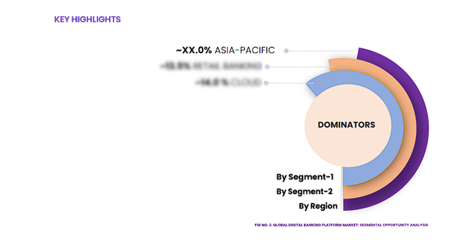
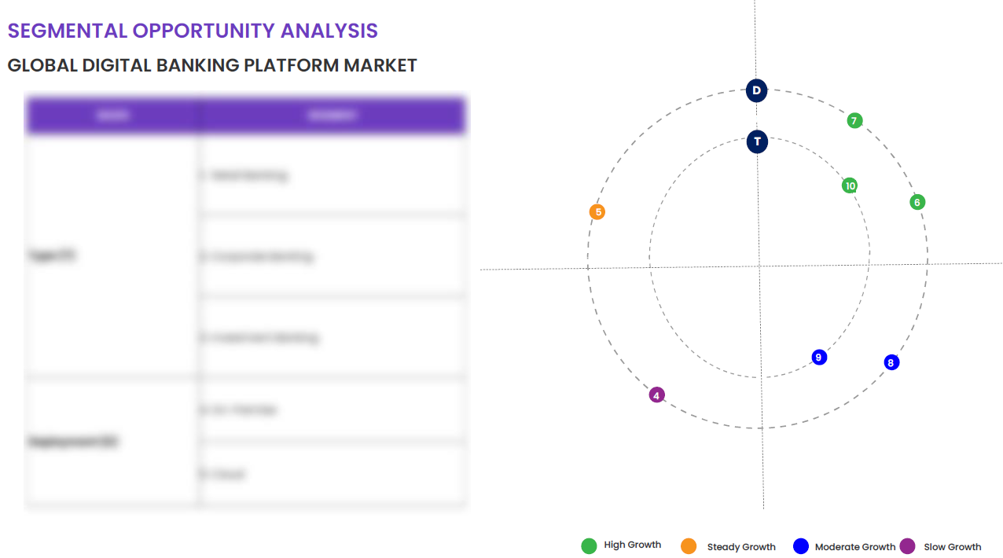
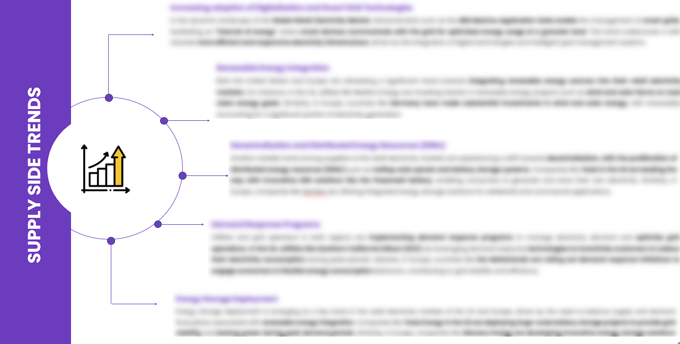
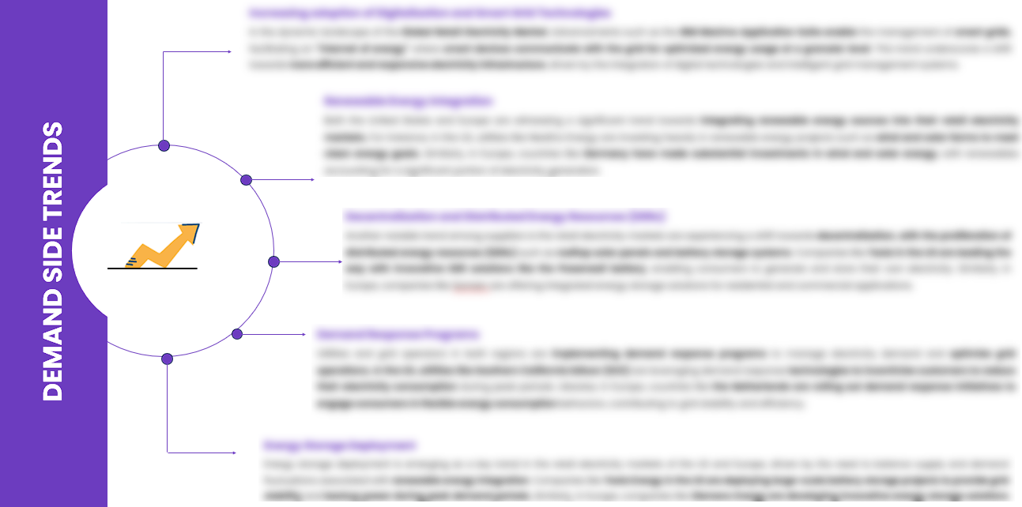
EXECUTIVE SUMMARY
SEGMENTAL OPPORTUNITY ANALYSIS
Global Market of Computers
Global Market of Computers,2024
21 Million
Global Market of Computers,2032
21 Million
SUPPLY SIDE TRENDS
DEMAND SIDE TRENDS

Slide 16
MARKET OVERVIEW
Market Drivers & Challenges
Market Attractiveness - Porters Five Analysis
Threat of New Entrants
Bargaining Power of Suppliers
Bargaining Power of Buyers
Threat of Substitute
Intensity of Competitive Rivalry
Global Market of Computers -
Historic Year 2019-2023 and Forecast to 2032

Slide 17

MARKET OVERVIEW: MARKET DRIVERS & OPPORTUNITIES
The Expanding Global Industry As A Key Driver For Global Market of Computers
The Type_1 industry is a rapidly growing area that is driving the global computer market's expansion through its innovative advancements in technology. This sector involves a variety of specialized computer equipment and systems needed for various tasks, including data storage, processing, and transmission. The increasing demand for more efficient and sophisticated computing capabilities by businesses, governmental institutions, and individual users worldwide offers immense opportunities for the computer industry to grow and thrive. The expansion of the Type_1 industry implies increased utilization of computers, thus stimulating the global computer market. Besides, the industry is also contributing to the development of cutting-edge hardware and software products, enhancing speed and efficiency. As cyber threats become increasingly sophisticated, the steadily growing Type_1 industry also demands stronger security solutions, pushing computer manufacturers to innovate continuously. Therefore, industry growth guarantees a dynamic and robust global computer market.

Slide 18

MARKET OVERVIEW: MARKET RESTRAINTS & CHALLENGES
High Initial Investment And Setup Costs Are Posing Challenge To The Growth Of The Market
The global computer market experiences significant growth constraints due to high initial investment and setup costs. High manufacturing costs, expensive raw materials, and costs related to research and development activities are primary contributors to these excessive costs. Potential investors or business owners are deterred from entering the market due to these formidable initial costs. As a result, the global computer market struggles to expand as effectively or rapidly as other technology sectors. The high setup costs pose another unique challenge to the growth of the global computer market. These costs include expenses related to equipment, licensing, software programming, and, crucially, the recruitment of skilled technicians for assembly-line setup. This presents a significant barrier to market entry for prospective businesses. Furthermore, these challenges hinder the market's capacity to stimulate competitive pricing among existing players which could hinder the innovation and product diversification necessary for the global computer market’s expansion.

Slide 19




MARKET OVERVIEW

Slide 20
KEY MARKET INSIGHTS
Top Investment and White Space Opportunities
Market Ecosystem Mapping
Technological Advancements, Benefits, & Impacts
Market Attractiveness Index, 2024
PESTEL Analysis
Macro-Economic Indicators
Pricing Analysis
Regulatory Landscape
Key Success Factors
Market Impacting Factors
Patent Analysis
Raw Material Analysis
Global Market of Computers-
Historic Year 2019-2023 and Forecast to 2032

Slide 21




KEY MARKET INSIGHTS

Slide 22
GLOBAL MARKET ANALYSIS, SEGMENTAL ANALYSIS
By Type_1, By Type_2
Global Market of Computers-
Historic Year 2019-2023 and Forecast to 2032

Slide 23

GLOBAL MARKET ANALYSIS – BY Type_1
Global Market of Computers SIZE, BY Type_1, 2019-2023 (USD Million)
Key Takeaways
 | 2019 | 2020 | 2021 | 2022 | 2023 | 2024 | 2025 | 2026 | 2027 | 2028 | 2029 | 2030 | 2031 | 2032 | CAGR (2025–2032)
Point_1.1 | XX | XX | XX | XX | XX | XX | XX | XX | XX | XX | XX | XX | XX | XX | XX%
Point_1.2 | XX | XX | XX | XX | XX | XX | XX | XX | XX | XX | XX | XX | XX | XX | XX%
Total | XX | XX | XX | XX | XX | XX | XX | XX | XX | XX | XX | XX | XX | XX | XX%
*Please note that this slide represents an indicative segmentation overview. the complete level-2 segmentation analysis will be covered in the Final Report.

Slide 24
GLOBAL MARKET ANALYSIS BY REGION
Global Market of Computers -
Historic Year 2019-2023 and Forecast to 2032

Slide 25


GLOBAL MARKET ANALYSIS BY REGION
Global Market of Computers: REGIONAL ANALYSIS, 2019-2023 (USD Million)
Key Takeaways
Europe
North America secured the foremost market share at 30.4%, and this dominance is projected to persist through the forecast period. This stronghold is attributed to the region's dense concentration of market competitors and an upsurge in cancer incidence rates. Notably, the U.S. witnessed approximately 1,806,590 new cancer diagnoses in 2020, as reported by the National Cancer Institute. The continuous integration of novel technologies, incorporating artificial intelligence, and the frequent launch of low-radiation CT scans are anticipated to further contribute to the region's market growth.
Conversely, Asia Pacific is poised for noteworthy growth, projected to experience a substantial Compound Annual Growth Rate (CAGR) over the forecast period. This surge can be attributed to the ongoing development of healthcare infrastructure, particularly in burgeoning economies such as India and China. The region's high adoption rate of advanced medical imaging devices, coupled with the increasing prevalence of chronic disorders, further fuels market expansion. Notably, local manufacturers in the region are gaining prominence, bolstering market growth.
North America
APAC
MEA
Latin America
Region | 2019 | 2020 | 2021 | 2022 | 2023 | 2024 | 2025 | 2026 | 2027 | 2028 | 2029 | 2030 | 2031 | 2032 | CAGR (2025-2032)
North America | XX | XX | XX | XX | XX | XX | XX | XX | XX | XX | XX | XX | XX | XX | XX%
Europe | XX | XX | XX | XX | XX | XX | XX | XX | XX | XX | XX | XX | XX | XX | XX%
Asia-Pacific | XX | XX | XX | XX | XX | XX | XX | XX | XX | XX | XX | XX | XX | XX | XX%
Latin America | XX | XX | XX | XX | XX | XX | XX | XX | XX | XX | XX | XX | XX | XX | XX%
Middle East & Africa | XX | XX | XX | XX | XX | XX | XX | XX | XX | XX | XX | XX | XX | XX | XX%
Total | XX | XX | XX | XX | XX | XX | XX | XX | XX | XX | XX | XX | XX | XX | XX%

Slide 26
NORTH AMERICA MARKET ANALYSIS – BY Type_1
NORTH AMERICA Global Market of Computers SIZE, BY Type_1, 2019-2023 (USD Million)
 | 2019 | 2020 | 2021 | 2022 | 2023 | 2024 | 2025 | 2026 | 2027 | 2028 | 2029 | 2030 | 2031 | 2032 | CAGR (2025–2032)
Point_1.1 | XX | XX | XX | XX | XX | XX | XX | XX | XX | XX | XX | XX | XX | XX | XX%
Point_1.2 | XX | XX | XX | XX | XX | XX | XX | XX | XX | XX | XX | XX | XX | XX | XX%
Total | XX | XX | XX | XX | XX | XX | XX | XX | XX | XX | XX | XX | XX | XX | XX%
Key Takeaways
*Please note that this slide represents an indicative segmentation overview. the complete level-2 segmentation analysis will be covered in the Final Report.

Slide 27
U.S. MARKET ANALYSIS – BY Type_1
U.S. Global Market of Computers SIZE, BY Type_1, 2019-2023 (USD Million)
 | 2019 | 2020 | 2021 | 2022 | 2023 | 2024 | 2025 | 2026 | 2027 | 2028 | 2029 | 2030 | 2031 | 2032 | CAGR (2025–2032)
Point_1.1 | XX | XX | XX | XX | XX | XX | XX | XX | XX | XX | XX | XX | XX | XX | XX%
Point_1.2 | XX | XX | XX | XX | XX | XX | XX | XX | XX | XX | XX | XX | XX | XX | XX%
Total | XX | XX | XX | XX | XX | XX | XX | XX | XX | XX | XX | XX | XX | XX | XX%
Key Takeaways
*Please note that this slide represents an indicative segmentation overview. the complete level-2 segmentation analysis will be covered in the Final Report.

Slide 28
COMPETITIVE DASHBOARD Top 5 Players Comparison Market Positioning of Key Players, 2023 Strategies Adopted By Key Market Players Recent Development Market Share Analysis, 2023
Global Market of Computers -
Historic Year 2019-2023 and Forecast to 2032

Slide 29




COMPETITIVE DASHBOARD
Why SkyQuest ?
Global 3D Printing Construction Market Competition Dashboard
The following figure represents the market positioning of Global Market of Computers players for the year 2023. The market positioning of the leading player is done considering the following points:

Slide 30
COMPETITIVE DASHBOARD
COMPETITORS | Apple Inc. | Company 2 | Company 3 | Company 4 | Company5
Headquarters | 1 Apple Park Way, Cupertino, California, U.S. | - | - | - | -
No of Employees | 147,000 (2021) | - | - | - | -
Revenue (US$) 2023 | 383.29 | - | - | - | -
Segmental Revenue (US$) 2024 | - | - | - | - | -
Product Overview | - | - | - | - | -
Geographic Presence | Worldwide | - | - | - | -
Year of Establishment | 1976 | - | - | - | -
Market Position | - | - | - | - | -

Slide 31
COMPANY PROFILES
Global Market of Computers -
Historic Year 2019-2023 and Forecast to 2032

Slide 32

Apple Inc. - COMPANY OVERVIEW
COMPANY AT A GLANCE
Established | 1976
Headquarter | 1 Apple Park Way, Cupertino, California, U.S.
Ownership | Public
Revenue (US$)- 2024 | 381.6
Employees | 147,000 (2021)
Website | www.apple.com
OVERVIEW
Apple Inc. is an American multinational technology company headquartered in Cupertino, California, that designs, develops, and sells consumer electronics, computer software, and online services. It is considered one of the Big Five companies in the U.S. information technology industry, along with Amazon, Google, Microsoft, and Facebook. Its hardware products include the iPhone smartphone, the iPad tablet computer, the Mac personal computer, the iPod portable media player, the Apple Watch smartwatch, and the Apple TV digital media player. Apple's software includes macOS, iOS, iPadOS, and watchOS operating systems, the iTunes media player, the Safari web browser, the Shazam music identifier, and the iLife and iWork creativity and productivity suites, as well as professional applications like Final Cut Pro X, Logic Pro, and Xcode. Its online services include the iTunes Store, the iOS App Store, Mac App Store, Apple Arcade, Apple Music, Apple TV+, iMessage, and iCloud.
PRODUCT OFFERING
PRODUCT NAME | DESCRIPTION
iPhone

Slide 33

Apple Inc. - FINANCIAL OVERVIEW
Apple Inc. - RECENT FINANCIALS IN USD BILLION (2022-2024) | Apple Inc. - BUSINESS REVENUE MIX, 2024 IN PERCENTAGE (%)
SKYQUEST'S TAKE ON THE COMPANY

Slide 34

Apple Inc. – KEY DEVELOPMENTS
DATE | TYPE OF DEVELOPMENT | DESCRIPTION
October 2023 | Partnership | Microsoft and Siemens are deepening their partnership by bringing the benefits of generative AI to industries worldwide. As a first step, the companies are introducing Siemens Industrial Copilot, an AI-powered jointly developed assistant aimed at improving human-machine collaboration in manufacturing. In addition, the launch of the integration between Siemens Teamcenter software for product lifecycle management and Microsoft Teams will further pave the way to enabling the industrial metaverse.
May 2023 | Product launch | Microsoft Corp. announced a suite of new AI solutions and improvements to Microsoft Clumping Clay for Nonprofit that are designed to transform the nonprofit industry and how fundraisers engage with donors, manage campaigns and optimize operations. In addition, the company announced a limited private preview for nonprofits to experience a new AI-powered fundraising propensity model.

Slide 35
ABOUT US & APPENDIX

Slide 36











ABOUT US
Established in 2006, SkyQuest is a Global Market Intelligence, Innovation Management organization that connects innovation to new markets, networks & collaborators for achieving sustainable development goals.
SOME OF OUR CLIENTS
180+ Institutional Clients 125000+ Streaming Clients 500+ Workshops Organized
Sectoral Coverage
| Information Technology | Clean Tech | Marketing & Advertising | Water | Life Sciences and Social | Social | Energy and Power | Food & Beverage | Training & E-Learnings & Materials | Semiconductor & Electronics | Oil & Gas | Banking, Financial, Capital Markets, Insurance

Slide 37
OUR CUSTOMIZED RESEARCH CAPABILITIES
CUSTOMER, DISTRIBUTOR, SUPPLIER INTELLIGENCE
TYPE INTELLIGENCE SUPPORT
Identification of potential partners
Shortlisting/finalization of potential partners
Customer need analysis
Customer's purchase and usage behavior
Customer/partner feedback and satisfaction
Brand perception analysis
Import and Export Intelligence
Commodity pricing intelligence
Product pricing intelligence
Product Positioning Assessment
New product launch tracker
Product claims assessment
Product Concept Testing
COMPETITIVE DASHBOARD SUPPORT
MARKET INTELLIGENCE SUPPORT
Company profiling
Competition assessment incl. market share
Drilled down revenue estimations
Employer value proposition
Market size and segmentation
Growth opportunities
Market dynamics and new developments
Go to Market Strategies
DATA COLLECTION AND ANALYSIS SUPPORT
MARKET STRUCTURE ASSESSMENT
Data analytics and visualization
Data collection, manipulation incl. web scraping
B2B and B2C surveys and interviews
Macroeconomic analysis
Value Chain and Communication Analysis
Regulatory assessment
Coating layer scouting and assessment

Slide 38
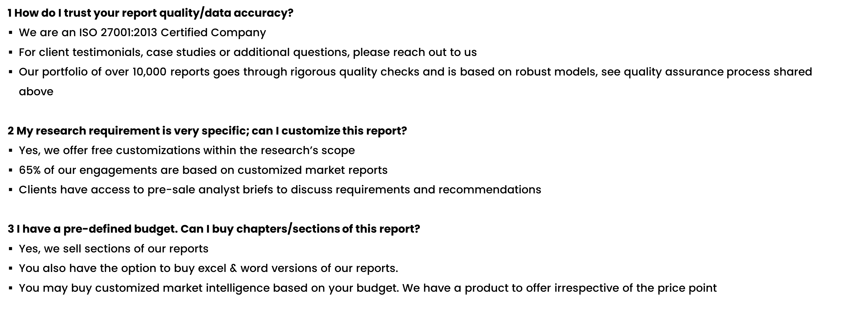

FAQs
NOTE

Slide 39






DISCLAIMER
SkyQuest provides strategic analysis to a select group of customers in response to orders. Our customers acknowledge when ordering that these strategic analysis for internal use and not for general publication or disclosure to any third party. SkyQuest does not endorse any vendor, product, or product type profiled in its publications. SkyQuest's strategic analysis constitutes estimations and projections based on secondary and primary research and are therefore subject to variations.
SkyQuest disclaims all warranties, expressed or implied, with respect to this research, including any warranties of merchantability or fitness, for any particular purpose. SkyQuest takes no responsibility for incorrect information supplied to it by manufacturers or users.
Trademarks, copyrights, and other forms of intellectual property belong to SkyQuest's respective owners and are protected by law. under no circumstance may any of these be reproduced, copied, or circulated in any form, without the prior written approval of SkyQuest's owner-as the case may be no part of this strategic analysis may be given, lent, resold, or disclosed to any third party, without express permission from SkyQuest team.
Reproduction and/or transmission in any form and by any means, including photocopying, mechanical, electronic, recording, or otherwise, without the permission of SkyQuest, is prohibited.
HEADQUARTERS
1 Apache Way, Westford, Massachusetts 01886, United States
APAC OFFICE
Room A & B, 2nd Floor, Lee Kee Commercial Building, 221-227, Queen’s Road Central, Hong Kong
GLOBAL DELIVERY CENTER
D-1001-1005, Swati Clover, Shilaj Circle, Sardar Patel Ring Rd, Thaltej, Ahmedabad, Gujrat-380054
WE ARE REACHABLE AT :-
info@skyquestt.com
+1-617-230-0741
www.skyquestt.com

Slide 40
THANK YOU
www.skyquestt.com

